Slide 1
Predicting HIV Drug Resistance Mutations Using Supervised Learning
By Gopalakrishnan Kumar, MTech IIT-Bombay,
Consultant Data Scientist
LinkedIn: Profile Link : https://www.linkedin.com/in/gopalakrishnankumar-a73301110/
Github:https://github.com/Gopal21236/
Kaggle URL- https://www.kaggle.com/gopalkk2

Slide 2
Google Colab URL
https://colab.research.google.com/drive/19A2dJ2BVZsgFYZGFyV_k8IIKxGTsuFw4?usp=sharing

Slide 3
Objectives
The main objectives of this project are:
To preprocess HIV genetic sequence data
To generate a supervised learning dataset
To visualize class distributions using plots
To train machine learning models
To predict HIV drug resistance mutations
To evaluate classification performance

Slide 4
Dataset Description
The dataset consists of HIV nucleotide sequences and corresponding resistance labels.
Dataset Structure
Column | Description
sequence | HIV nucleotide sequence
label | Drug resistance class
Label Description
Label | Meaning
0 | Non-resistant
1 | Drug-resistant

Slide 5
Sample Dataset
sequence | label
ATGCGTACGTAGCTAGCTAGCTAGCTAGCTAGCTAGCTA | 0
ATGCGTACGTAGCTAGCTAGCTAGTTAGCTAGCTAGCTA | 1

Slide 6
Synthetic Dataset Generation
Synthetic datasets were generated to simulate HIV mutation patterns for supervised learning experiments.

Slide 7
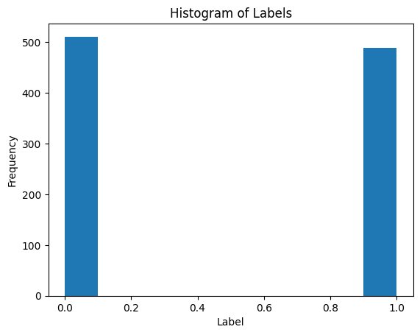
Data Visualization

Slide 8
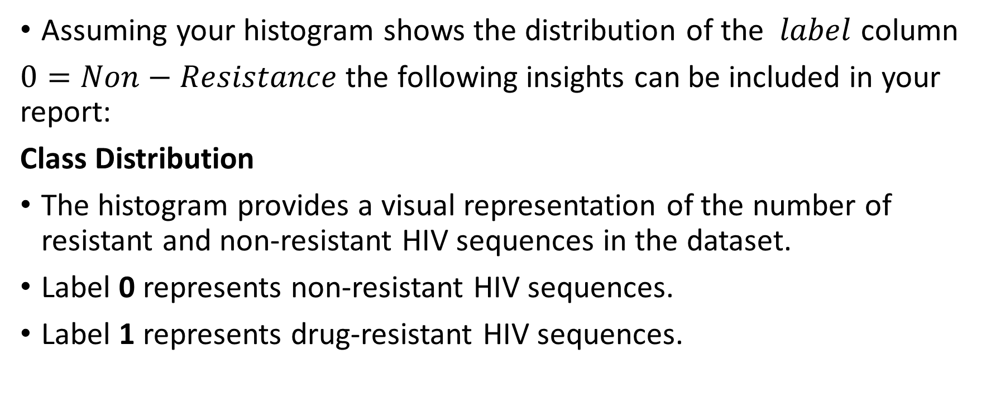
Histogram Plot
Assuming your histogram shows the distribution of the $label$ column
$0=Non−Resistance$ the following insights can be included in your report:
Class Distribution
The histogram provides a visual representation of the number of resistant and non-resistant HIV sequences in the dataset.
Label 0 represents non-resistant HIV sequences.
Label 1 represents drug-resistant HIV sequences.

Slide 9
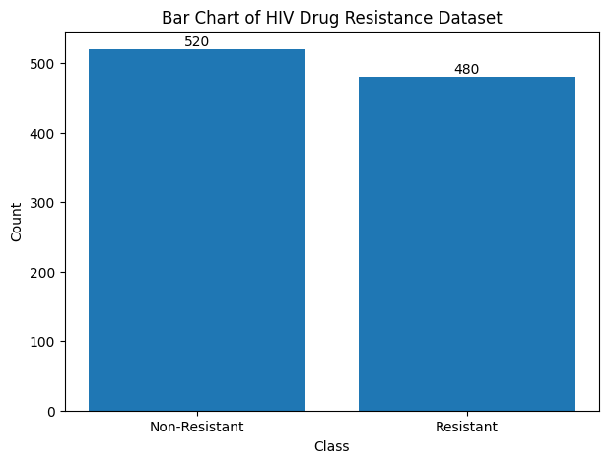
Data Visualization

Slide 10
Bar Chart Plot
Dataset Balance
A balanced dataset is desirable for supervised learning.
If both bars have similar heights, the dataset is balanced.
Balanced datasets generally improve model performance and reduce prediction bias.
Example:
Class | Count
Non-Resistant | 500
Resistant | 500
This indicates a well-balanced dataset.

Slide 11
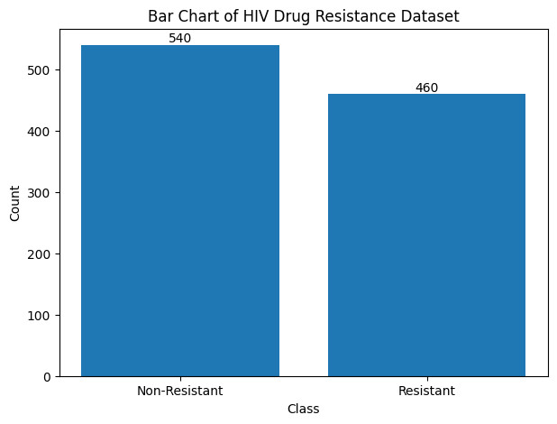
Data Visualization

Slide 12
Bar Chart Plot
Potential Class Imbalance
Class | Count
Non-Resistant | 850
Resistant | 150
This indicates class imbalance, which may cause:
Biased predictions
Lower recall for minority class
Reduced model generalization
Possible solutions:
Oversampling
Undersampling
SMOTE
Class weighting

Slide 13
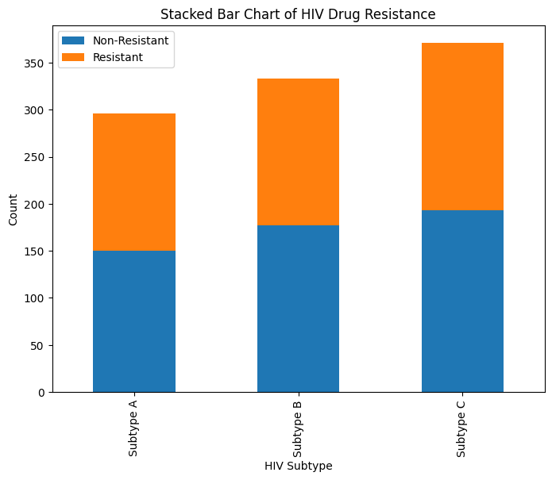
Data Visualization

Slide 14
Stacked Bar Chart Plot
Drug resistance is not confined to a single subtype.
This indicates:
Broad mutation occurrence
Need for subtype-independent predictive models
Subtype B contributes the largest number of resistant samples.
Potential implications:
Higher mutation frequency
Greater treatment challenges
Each subtype contains both resistant and non-resistant samples.
Benefits:
Improved model learning
Reduced classification bias

Slide 15
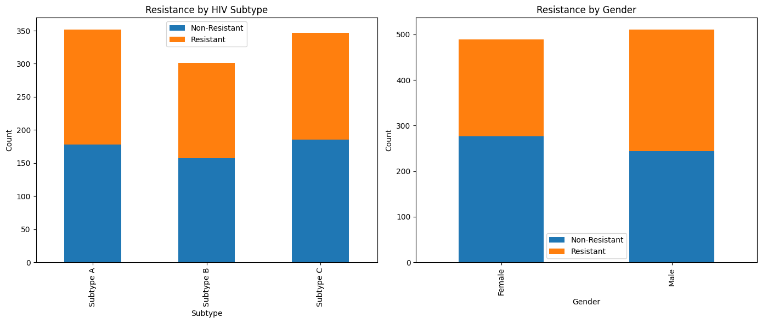
Data Visualization

Slide 16
Combined Stacked Bar Plot
The combined stacked bar chart extends the analysis by comparing multiple categorical variables simultaneously.
Variables included:
HIV Subtype
Gender

Slide 17
Biological Interpretation
For HIV drug resistance prediction:
Non-resistant sequences indicate susceptibility to antiretroviral drugs.
Resistant sequences contain mutations associated with reduced drug effectiveness.
The histogram provides an overview of how frequently resistance-associated mutations occur within the dataset.

Slide 18
Research Significance
Research Significance
The visualization helps researchers:
Understand mutation prevalence
Evaluate resistance patterns
Assess dataset readiness for predictive modeling
Support development of personalized treatment strategies

Slide 19
Conclusion
The histogram is an essential exploratory data analysis (EDA) tool that reveals the distribution of HIV drug resistance classes. A balanced distribution indicates a suitable dataset for supervised learning, while an imbalanced distribution highlights the need for preprocessing techniques before model training. These insights guide the selection of appropriate machine learning methods and evaluation strategies for HIV drug resistance prediction.

